Slide 1

Tentative Title: Improving the Accuracy of Heart Disease Prediction and Comparison Using Data Mining Techniques
Supervisor,
Dr. Mir Md. Jahangir Kabir
Professor
Department of CSE, RUET.
Presented By,
Md. Abdul Hakim
Roll No : 1503032
Department of CSE, RUET.

Slide 2
Index
Objectives
Introduction
Motivation
Literature Review
Methodology
Proposed method
Dataset
Limitations
Conclusion
Future works
References

Slide 3
Objectives
To select a best approach to analysis and predict the disease more accurately
Improving the prediction accuracy

Slide 4
Introduction
Heart diseases have emerged as the number one cause of deaths.
So, with the help of data mining techniques, doctors will be able to make future predictions.
The prediction models make predictions on patients based on previous patterns in the past.
Reduce the number of deaths of patients.

Slide 5

Motivation
It is a better approximation of public health.
In future world will be dominated by data.
the doctor can take appropriate action to help the patient
fig 1: Motivation

Slide 6
Literature Review
Heart Disease Prediction Using Data Mining Techniques[1]
-ching se wu, Mustafa Badshah
Heart Disease Prediction Using Data Mining Techniqes[2]
-Abhishek Rairikar, Vedant Kulkarni
Improving the accuracy of prediction of heart disease risk based on ensemble classification techniques[3]
-C. Beulah Christalin Latha
Prediction of Heart Disease using Classification Algorithms [4]
-Daniel Masethe,Mosima Anna

Slide 7
Methodology
Naive Bayes:
Bayes theorem named after Thomas Bayes.
It works on conditional probability.
Using the conditional probability, we can calculate the probability of an event using its prior knowledge.

Slide 8
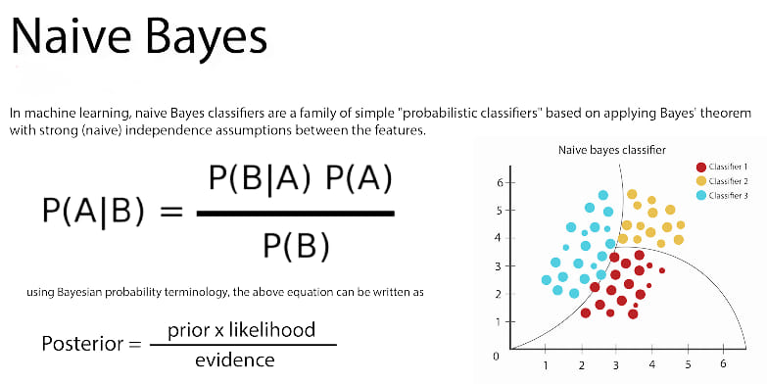
Methodology

Slide 9
Methodology
Support Vector Machine(SVM):
A supervised learning approach use labeled data
It saperates sample by a hyper-plane.
In two dimensional space this hyper-plane is a line dividing a plane in two parts

Slide 10
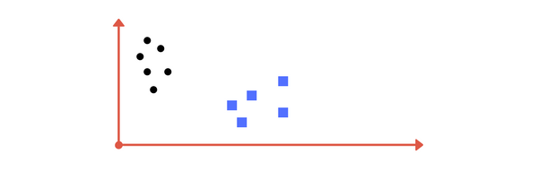
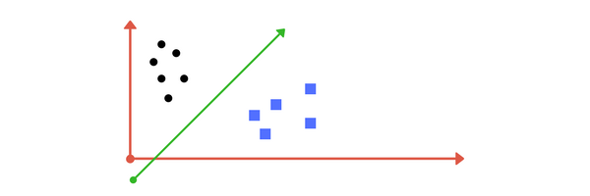
Methodology
Image A: Draw a line that separates black circles and blue squares.
Image B: Sample cut to divide into two classes.

Slide 11
Methodology
Random Forest
An ensemble learning algorithm
It builds multiple decision trees and merges them together to get a more accurate and stable prediction.
Handle the missing value and maintain accuracy

Slide 12
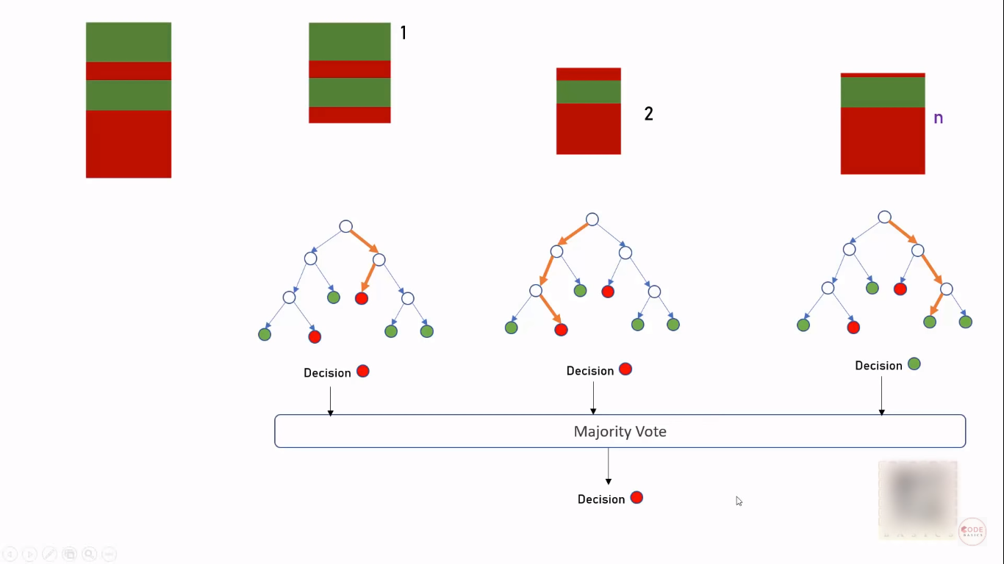
Random Forest

Slide 13
Proposed Method
start
Train the dataset
comparison and observation of all the classifiers.
Collect heart disease data-set
Run the dataset into many classifiers algorithm.
End
Observe Dataset
Calculation using algorithm

Slide 14
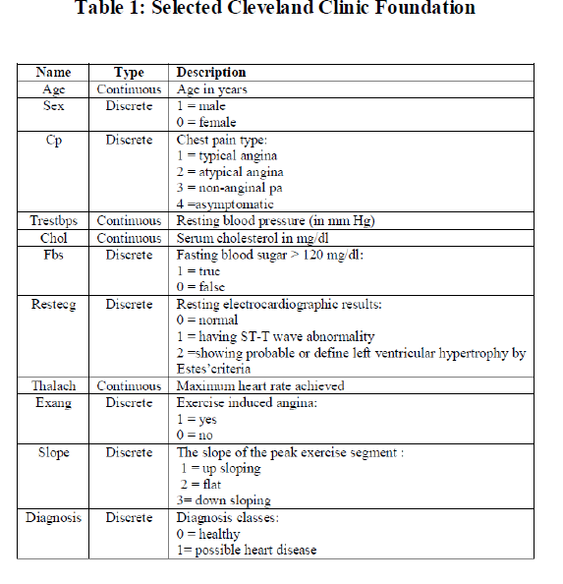
Data-Set

Slide 15
Limitations
Accuracy is not yet high as expected
Doesn't give good prediction for very high dimesional data
Is not applicable in medical image data

Slide 16
Conclusion
Just focused on the prediction of these classifier applied in this paper
Naive Bayes has high accuracy on High dimensional data
Random Forest gives high accuracy on small dimensional data

Slide 17
Future works
This studies extends more machine learning Algorithms and preposseing techniques
Could be extended on distributed environment on single node machine
Further inspires to predict on medical image processing

Slide 18
References
DatasetLink: https://www.kaggle.com/ronitf/heart-disease-uci
[1].https://www.researchgate.net/publication/335479798_Heart_Disease_Prediction_Using_Data_Mining_Techniques
[2].https://www.researchgate.net/publication/334761240_HEART_DISEASE_PREDICTION_USING_DATA_MINING_TECHNIQUES
[3].https://www.sciencedirect.com/science/article/pii/S235291481830217X
[4].https://pdfs.semanticscholar.org/39dd/c58d3d76474e894a48330723abd587535749.pdf

Slide 19
Thank You

